Slide 1
UNLOCK THE DATA WITH eda & autoeda
Exploring the world of data analysis

Slide 2
01 Intro to eda
03 Needs and importance of EDA
03 Steps in eda
04 Visualization tools & tECHNIQUES
Table of Contents:
05
Automated eda & Technique
06
HANDS ON WITH EDA & AUTOEDA

Slide 3
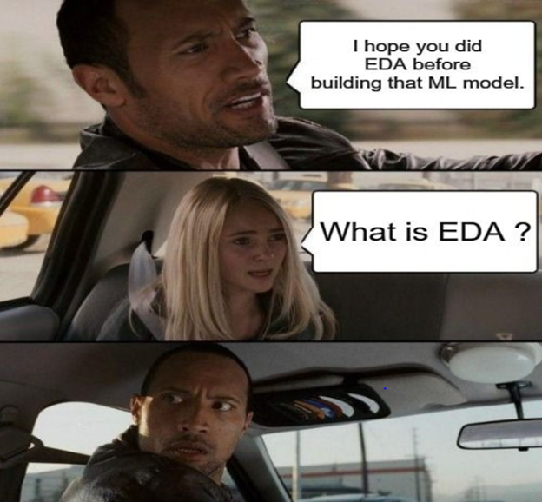
INTRO TO EDA

Slide 4
01. Intro to EDA

Slide 5
INTRODUCTION
Exploratory Data Analysis (EDA) is a data analysis approach that involves the initial exploration and visualization of data to identify patterns, relationships, and anomalies.

Slide 6
—"Exploratory Data Analysis" by Tukey, J.W. (1977)
“The goal of EDA is to gain a better understanding of the underlying structure and characteristics of the data, to develop hypotheses about the relationships between variables, and to identify potential problems with the data that need to be addressed”
“The goal of EDA is to gain a better understanding of the underlying structure and characteristics of the data, to develop hypotheses about the relationships between variables, and to identify potential problems with the data that need to be addressed”

Slide 7
02. needs and importance of eda
We may miss important patterns or relationships in the data. Inaccurate or incomplete analyses and models. Result in poor decision making, wasted resources, and missed opportunities for businesses

Slide 8

WHY DO WE NEED EDA?
Identify Data Quality.
To Identify relationship and patterns.
To select actual features.
To Improve the accuracy of model.
Effectively communicate actionable insights.
Effectively communicate actionable insights.

Slide 9

WHY DO WE NEED EDA?
Better Decision Making.
Save Time and Resources.
Business / Organization Impact.

Slide 10
HOW EDA HELPS DATA SCIENCE AND MACHINE LEARNING
Understanding the Data
Selecting relevant features
Preprocessing the data
To formulate hypothesis
Model Selection and Validation (help in identifying potential biases and issues with the model)
Visualization Communication

Slide 11
03. Steps in Exploratory Data Analysis

Slide 12
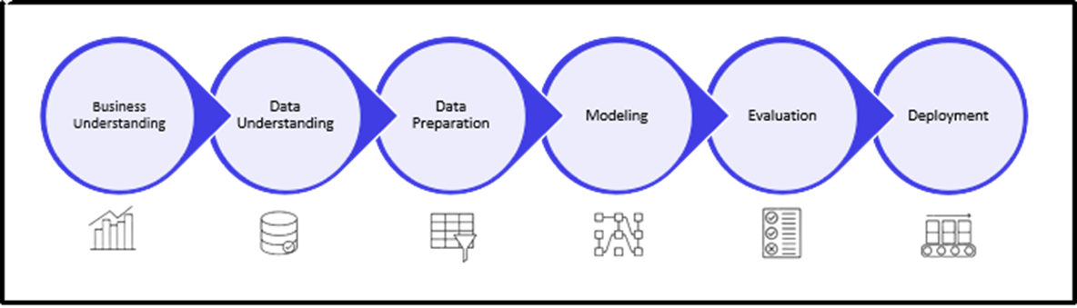
Steps in machine LEARNING

Slide 13
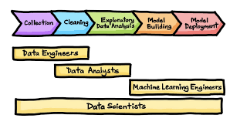
Steps in machine LEARNING

Slide 14
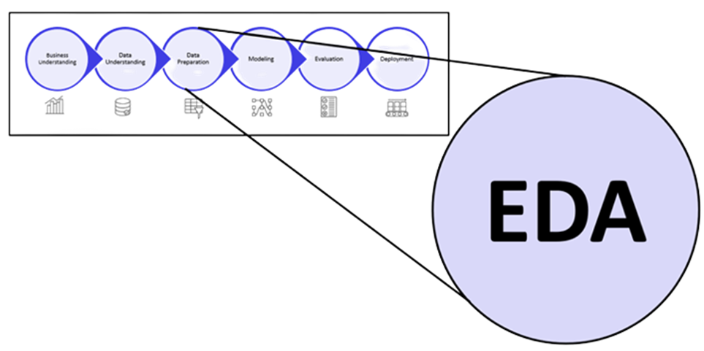
Eda comes under data preparation and analysis

Slide 15

Steps involved in edA
Data Collection
Data Cleaning (Identifying and handling missing data, outliers, or other issues)
Data Transformation (converting data types, scaling data, or creating new features from existing data)
Data visualization
Statistical analysis
Interpretation and reporting

Slide 16
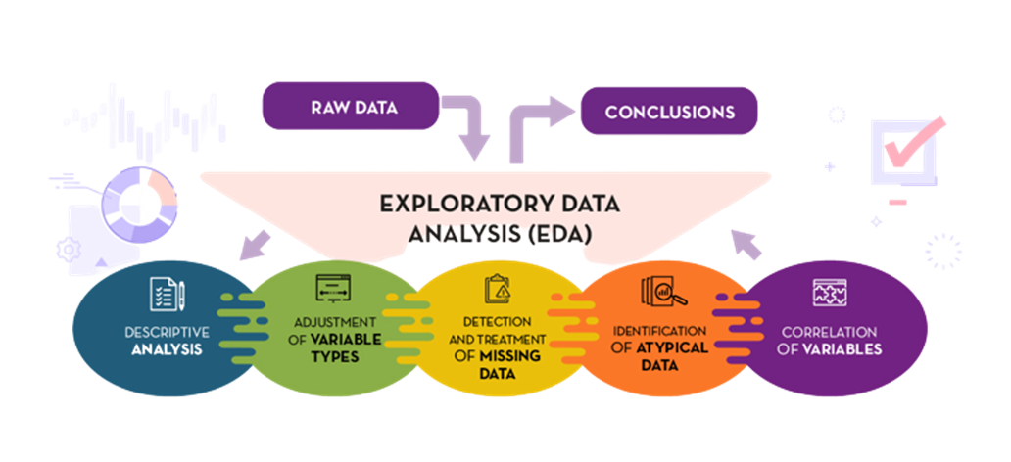
Steps involved in edA

Slide 17
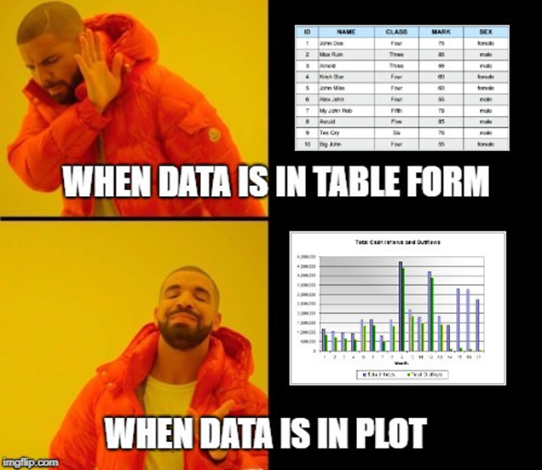
Data Visualization

Slide 18
04. Visualization techniques and tools

Slide 19
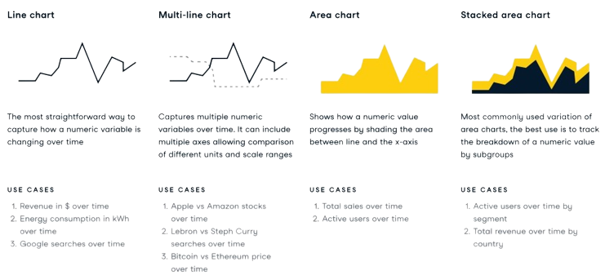
VISUALIZATION TECHNIQUES

Slide 20
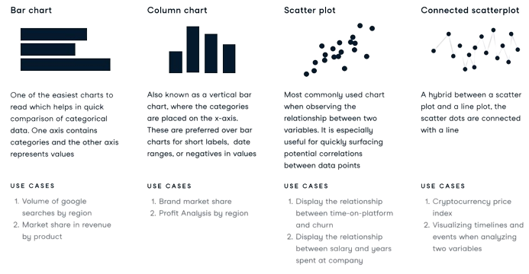
VISUALIZATION TECHNIQUES

Slide 21
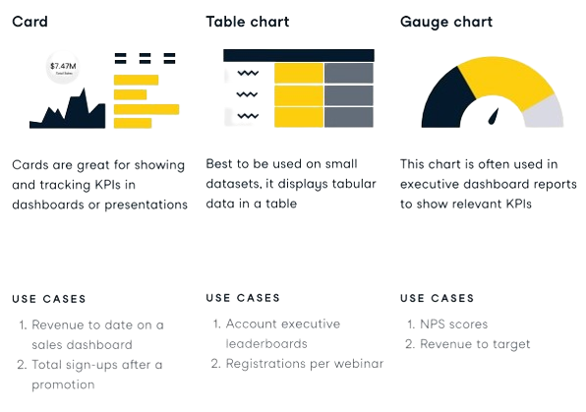
VISUALIZATION TECHNIQUES

Slide 22
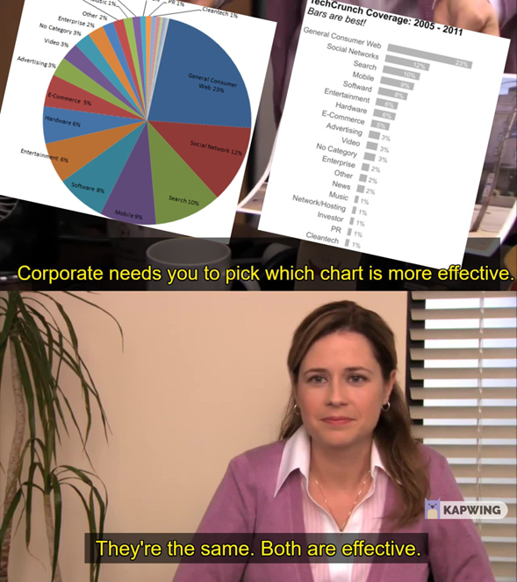
Data Visualization

Slide 23

Various visualization techniques

Slide 24
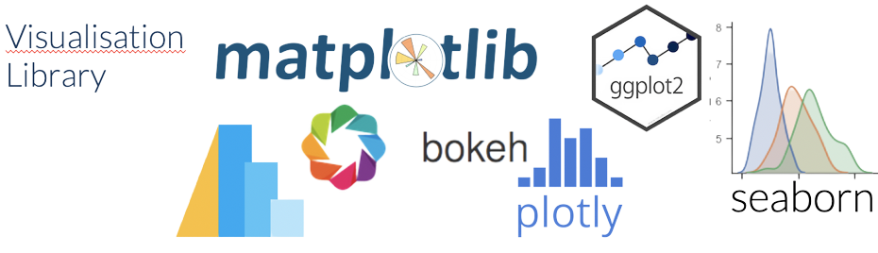
Various visualization Libraries

Slide 25
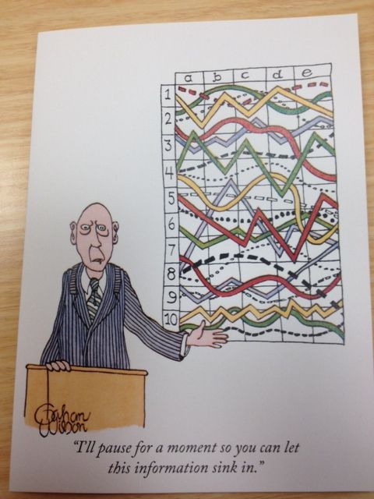
Data Visualization

Slide 26
05. AUTOMATED EDA & TECHNIQUES

Slide 27
What is AUTOEDA?
“ The process of automatically performing various data analysis tasks using algorithms and software tools, with the aim of generating insights and understanding patterns in the data”

Slide 28
WHY DO WE NEED AUTOEDA?
Manual exploratory data analysis can be a time-consuming process, particularly for large datasets with numerous variables.
It can help to identify key trends, patterns and relationships between variables, that can be further investigated with statistical models.
Standardization can help to reduce errors and improve the reliability of the analysis.

Slide 29
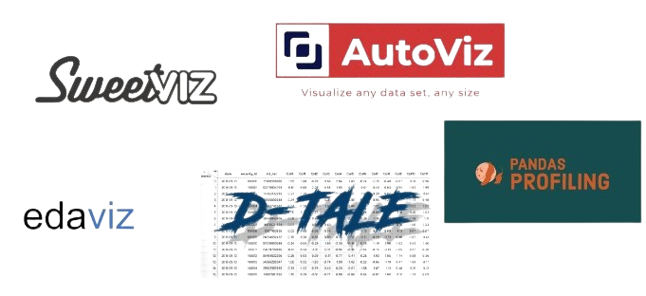
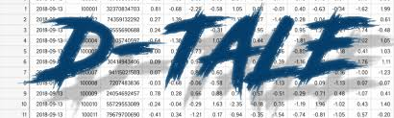
Various AutoEDA Libraries

Slide 30
PROS OF AUTOEDA
AutoEDA can perform various data analysis tasks much faster than humans, reducing the time required to clean, process and analyze data.
AutoEDA automates several time-consuming and repetitive tasks.
AutoEDA tools can be accessed easily and used by non-technical users as well.
AutoEDA can handle large and complex datasets.

Slide 31
CONS OF AUTOEDA
AutoEDA algorithms lack the domain expertise required to identify relevant variables, interpret results accurately.
Designed to perform predefined data analysis tasks and may not be customizable.
Over-reliance on AutoEDA can lead to a lack of critical thinking and the inability to identify errors or biases.
May not always detect or correct data quality issues, such as missing or incorrect data.

Slide 32
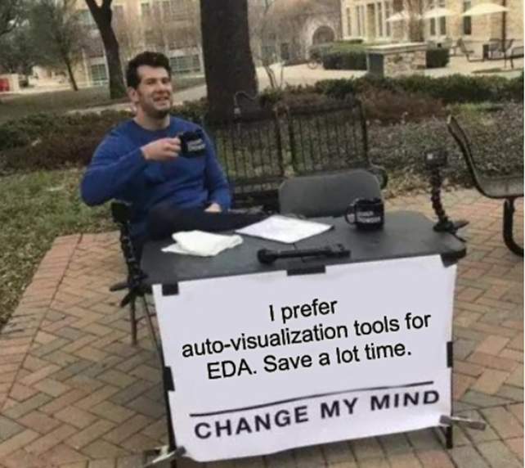
Automated eda & techniques

Slide 33

Data Visualization

Slide 34
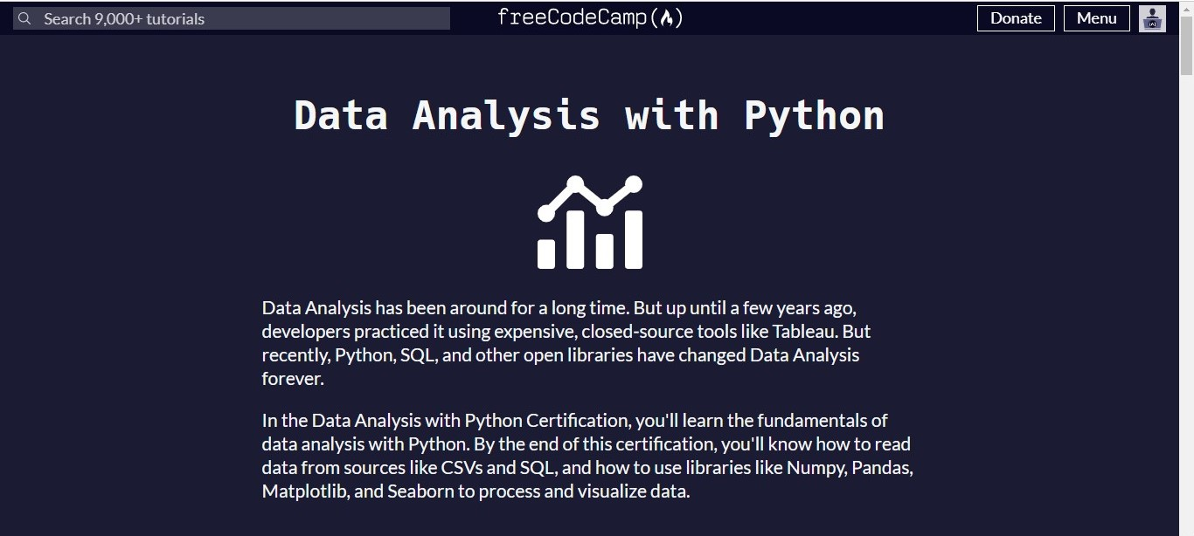
Data Visualization

Slide 35

Data Visualization

Slide 36

Data Visualization

Slide 37

Data Visualization

Slide 38
06. Hands on with eda & autoeda

Slide 39
THANKS
Does anyone have any questions?
Please keep this slide for attribution.

Slide 40
Fonts & colors used
This presentation has been made using the following fonts:
Staatliches
(https://fonts.google.com/specimen/Staatliches)
Anaheim
(https://fonts.google.com/specimen/Anaheim)
#434343
#f3f3f3
#fafafa
#ffb37a
#ffa45f
#e78841
#d16717

Slide 41


